Slide 1
RockHound Output
P3_JoeyBloom_Assign44_RockHound

Slide 2
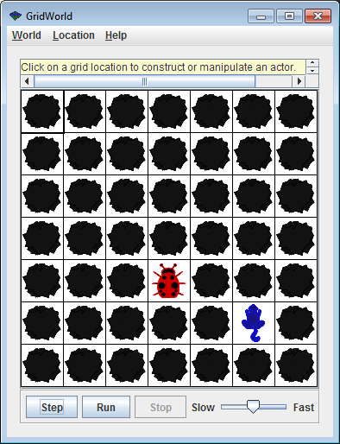
INITIAL SETUP

Slide 3
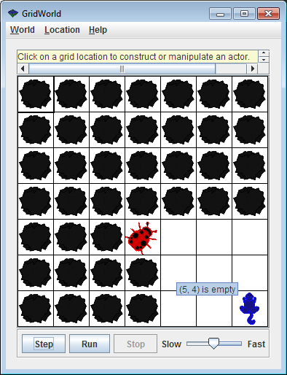
Eats rocks around it

Slide 4
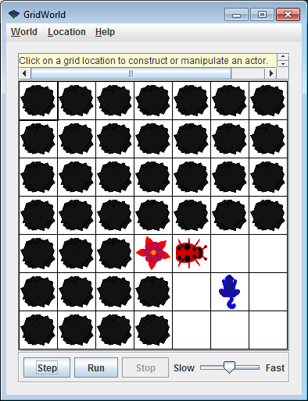

Slide 5


Slide 6
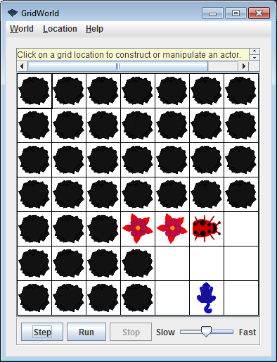
Doesn’t eat Bug

Slide 7
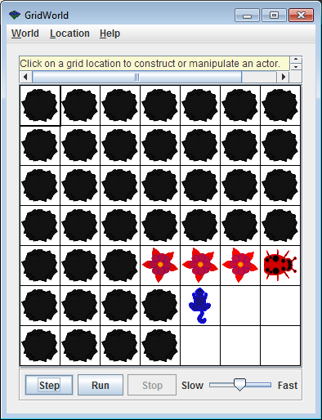

Slide 8
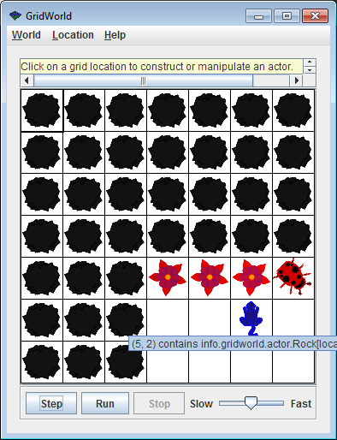
Doesn’t eat Flower

